Slide 1
Texas State Transportation Innovation Council (TxSTIC)
Tuesday, July 25th, 1:00 PM – 3:30PM - CST

Slide 2
Lunch
Box Lunches Pick-up

Slide 3
Benjamin King
TxDOT, Section Director, Innovation Section
Strategic Planning Division

Slide 4

Safety Moment

Slide 5
TxSTIC Meeting Agenda
1
Welcome and Safety Briefing
2
FHWA Updates
3
Local Aid Support Team Initiatives
4
STIC Incentive Project Updates
5
Break
EDC 5 Project Update
6
7
Planning for ITS Growth
8
Updates
Notes:
1:00 PM | Welcome and Safety Briefing – Benjamin King, Section Director, Innovation Section
TxDOT Strategic Planning Division
1:15 PM | FHWA Updates – Center for Accelerating Innovation
Kirk Fauver, FHWA Texas Division, Planning & Research Engineer
1:30 PM | Local Aid Support Team Initiatives – Trinnette Ballard, Local Aid Support Manager
Office of Innovation and Workforce Solutions, FHWA
1:45 PM | STIC Incentive Project Updates – Strategic Workforce Development Update
Ray Belk, TxLTAP – WFD Phase II
2:00 PM | Break
2:15 PM | EDC 5 Project Update – Weather Responsive Management Strategies
Kenneth Perrine, Research Associate, Center for Transportation Research
2:30 PM | Planning for ITS Growth – Jeff Miles, District Design Engineer,
TxDOT Bryan District
2:45 PM | Updates – Darran Anderson, TxDOT, Director of Strategy and Innovation, TxSTIC Co-Chair

Slide 6
TxSTIC Meeting Agenda
9
Council Roundtable
10
Closing Remarks
11
Adjourn
Notes:
2:55 PM | Council Roundtable – Member Updates
3:15 PM | Closing Remarks – Erika Kemp, Strategic Planning Division Director, TxDOT
3:30 PM | Adjourn

Slide 7
Douglas Mikowski
FHWA, Wyoming Division
Acting STIC Coordinator

Slide 8




CAI Updates
Center for Accelerating Innovation
Acting STIC Coordinator
Douglas Mikowski
https://www.fhwa.dot.gov/innovation/
Notes:
Hello everyone. My name is Douglas Mikowski and I am currently the Acting STIC coordinator. I have been asked to give you current updates for the Center for Accelerating Innovation or CAI. CAI has four programs currently; State Transportation Innovation Council which I am acting program manager for Sara Lowry who will return at the end of August, Every Day Counts which is currently on round seven and is managed by Julie Zirlin; Accelerated Innovation Deployment with Fawn Thompson as the program manager; and Accelerating Market Readiness currently overseen by the Director of CAI, Jeffrey Zaharewicz. I have provided a link at the bottom of this slide where you can find more information on all these programs. - NEXT SLIDE

Slide 9
CAI Updates
STIC
  STIC Excellence Award applications currently under review.
EDC-7
  Baseline reporting is complete, and results are posted.
  EDC-7 Summit Summary and Baseline Report (dot.gov)
AID
  Expect announcements soon.
AMR
  No updates at this time.
Notes:
For CAI updates today I would like to share the following.
For the STIC program. We have received the applications for this year and currently are reviewing the submittals. We hope to announce this year’s winner soon.
For the EDC program. EDC round seven is well underway. Currently the baseline reporting has been completed and the results can be reviewed at the link provided on this slide.
For the AID program. There are no new updates, but we are hoping to provide a much-awaited announcement in the near future.
For the AMR program. I have no updates at this time
Are there any questions?
I want to express my gratitude on having this opportunity to participate in your meeting today. As a temporary representative who has only recently been involved in this program, it is beneficial to be able to experience a council meeting in person. I look forward to helping Texas to push innovation forward while in this position.
Thank you.

Slide 10
Trinnette Ballard
FHWA, Office of Innovation and Workforce Solutions
Local Aid Support Manager

Slide 11

FHWA Local Aid Support Team for
Texas STIC Summer Meeting
Trinette Ballard
Local Aid Support Program Manager
Office of Transportation Innovation and Workforce Solutions

Slide 12
FHWA Leadership
Office of Innovation and Workforce Solutions
Office of Innovation Implementation – Resource Ctr
Office of Innovation Management, Education and Partnerships
Local Aid Support
Workforce Development
EDC
NHI

Slide 13
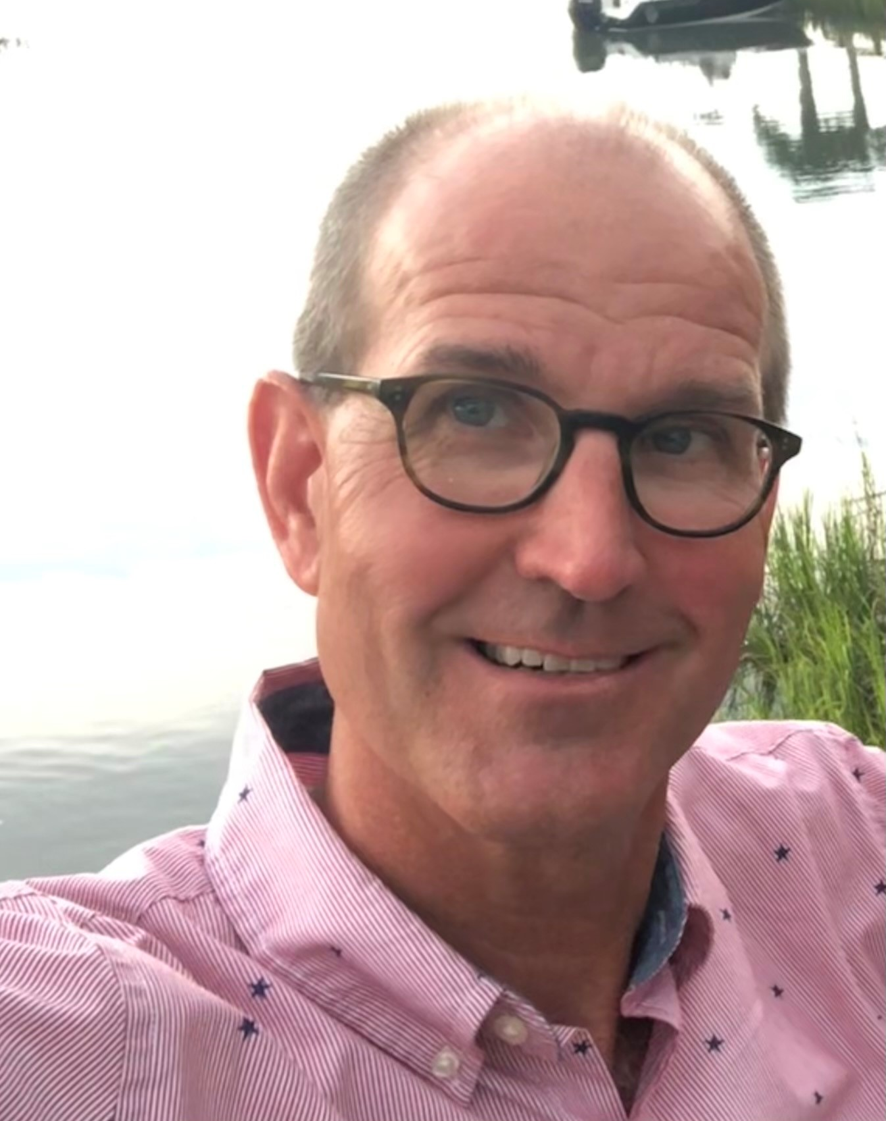
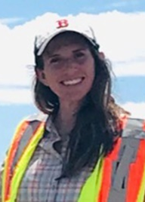

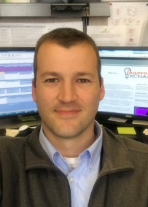

Hello from the Local Aid Support Team
We provide training, technical assistance, and technology transfer services to build capacity for our Local and Tribal stakeholders that will enhance roadway networks, create economic opportunity, and improve safety and quality of life.
Joe Conway
Local Aid Support Director
Joe.conway@dot.gov
Morgan Manning
TTAP Program Manager
Morgan.malley@dot.gov
Danielle Mathis-Lee
LTAP Program Manager
Danielle.mathis-lee@dot.gov
Hans Anker
Innovation
Program Manager
Hans.anker@dot.gov
Trinette Ballard
Marketing
Program Manager
Trinette.ballard@dot.gov

Slide 14

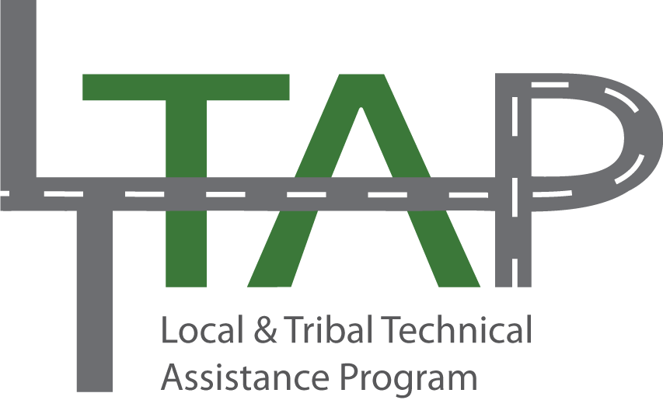
LAS Roles and Responsibilities
- Set strategic direction of LTAP/TTAP
- Provide program oversight
- Review annual Center work plans
- Provide annual LTAP funding
- Actively collaborate with LTAP/TTAP Centers
- Provide technical assistance and support
- Provide marketing and outreach support
Local Aid Support Team
(LAS)
TTAP Centers
Tribal Technical Assistance Program (TTAP)
LTAP Centers
Local Technical Assistance Program
Local Technical Assistance Program (LTAP)
51 Centers (Located in a State DOT or University)
7 Regional Centers (based on Bureau of Indian Affairs Regions)
Notes:
LTAP: https://www.fhwa.dot.gov/clas/ltap/
TTAP: https://www.fhwa.dot.gov/clas/ttap/

Slide 15
HOW is the LTAP / TTAP delivered?
FHWA Local Aid Support (LAS) team Program Managers administer the LTAP/TTAP Program through coordination with Technical Assistance Centers that deliver local transportation training and education services.
LTAP
The LTAP requires a 50% local match and is delivered on a statewide scale with 51 LTAP Centers.
Agreements are held between LTAP Centers and State DOTs, which are coordinated with FHWA LAS.
TTAP
The TTAP requires no match and will be delivered on a regional scale with 7 TTAP Centers aligned with Bureau of Indian Affairs regional boundaries.
Agreements are held directly between TTAP Centers and FHWA LAS.

Slide 16



TRAINING
Develop & Expand Expertise
Develop standardized course curriculum
and material that meet the needs of
Local and Tribal communities.
Core Service
Areas
TECHNICAL ASSISTANCE
Solve Problems
Provide transportation technical assistance
that best suits the needs of Local and Tribal
Communities that strengthen capacity for
management and delivery of transportation
programs and projects.
TECHNOLOGY TRANSFER
Deliver Innovations
Advance innovation through identification and deployment of technologies and practices best suited for Local and Tribal unique transportation challenges, in cooperation with Tribal, Federal, State, Local, and private sector partners.

Slide 17
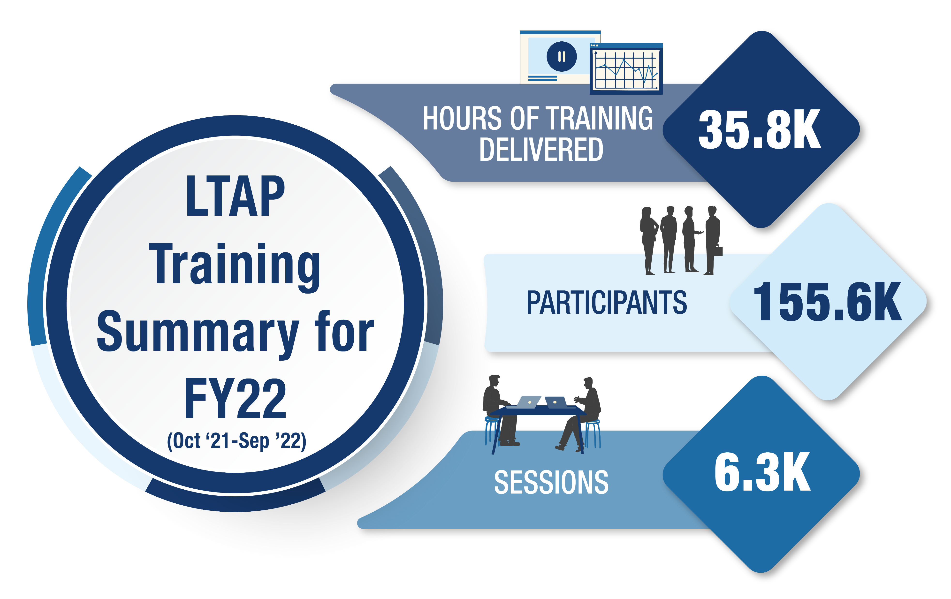

Slide 18

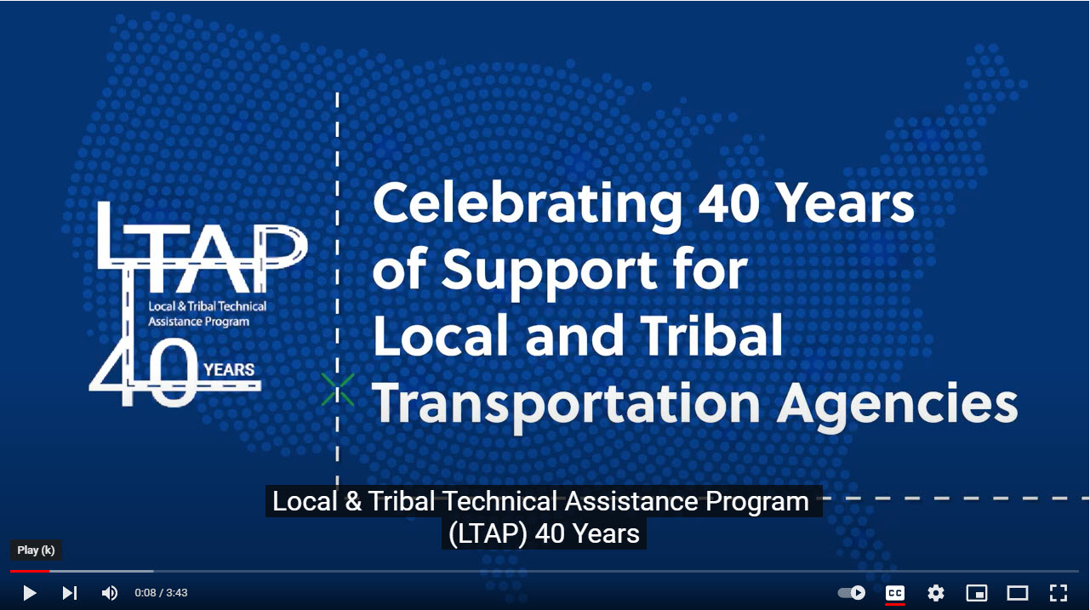
40 years of LTAP/TTAP

Slide 19
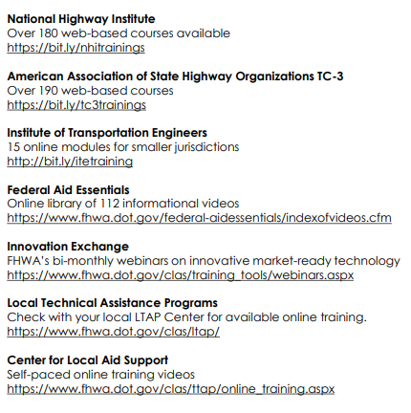
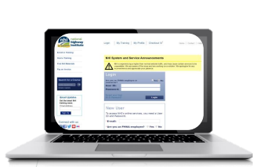
Online
Training
Courses
FHWA Local Aid Support – Office of Innovation and Workforce Solutions
Notes:
The Federal Highway Administration’s Center for Local Aid Support is sponsoring online training courses for the local agencies and tribal communities. This is your guide to anytime, anywhere access to hundreds of training topics designed to meet your individual needs. With dozens of hours of content currently available and continual updates to the course curriculum, participants can continue their education in transportation topics from beginner to advanced. If you have not tried one of these self-paced courses yet, now is the time to experience enhanced learning available to you through FHWA. All you will need to get started is internet connection. A big thank you to our partners AASHTO, National Highway Institute and the Institute for Transportation Engineers. Making the online training available is important to ensuring continuity in the delivery of safe and efficient transportation assets to local and tribal communities. 24/7 training that is self-paced eliminates the challenges many agencies face with budget constraints; workforce shortages; and changing transportation needs. But, on-demand does not have to mean that you are on your own! The Local Technical Assistance Centers in each state and Puerto Rico continue to provide technical assistance and live training in addition to what is already available to you online. We hope you find this guide useful and essential to keeping you knowledgeable and innovative in your solutions to improving transportation for your communities. Be sure to pay attention to required passcodes and use your government email for registration. If you do not have a government email, please contact CLAS@dot.gov for further assistance.

Slide 20
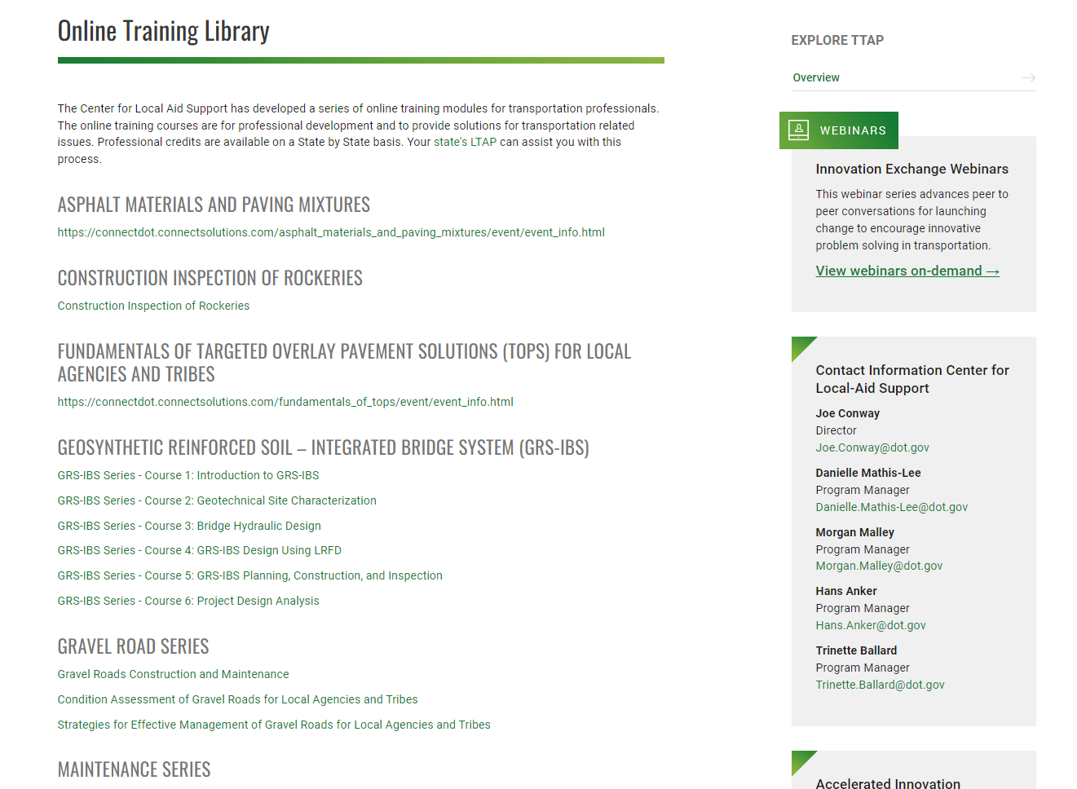
Local Aid Support Online Training
Notes:
https://www.fhwa.dot.gov/clas/online_training.aspx

Slide 21
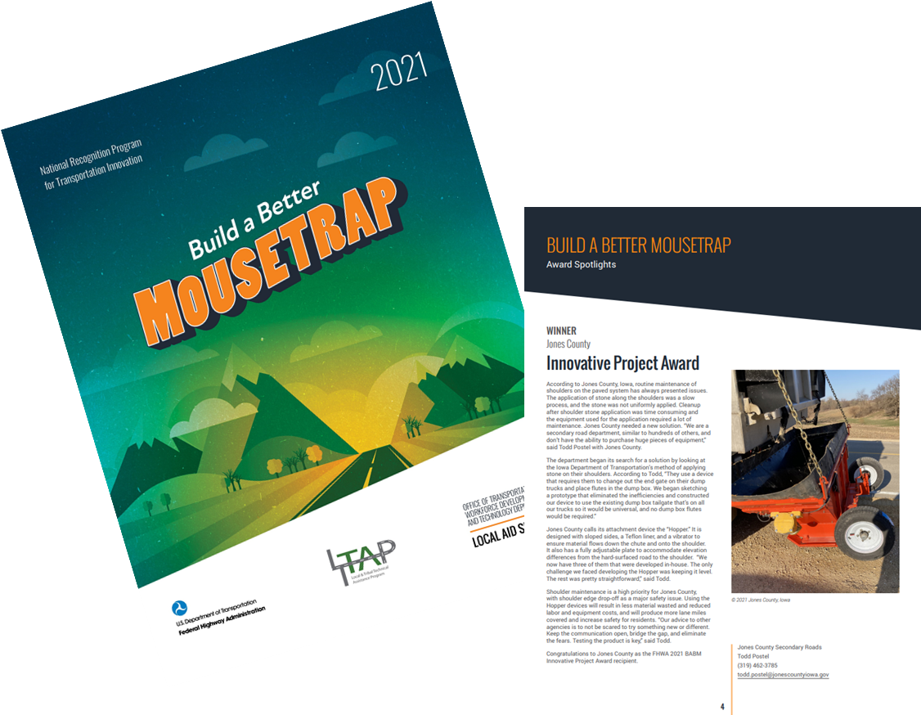

Build a Better Mousetrap
National Competition for state, local and Tribal agencies who use home grown innovation to solve problems
Four categories: 1) Innovative Project; 2) Bold Steps; 3) Pioneer; 4) Smart Transformation
53 nominations from 20 States and a Tribe in 2023
Both national and state winners’ innovations are highlighted in Build a Better Mousetrap booklet
Purpose of the program is to recognize innovative agencies while encouraging other agencies to do the same.
Notes:
https://www.fhwa.dot.gov/clas/babm/

Slide 22

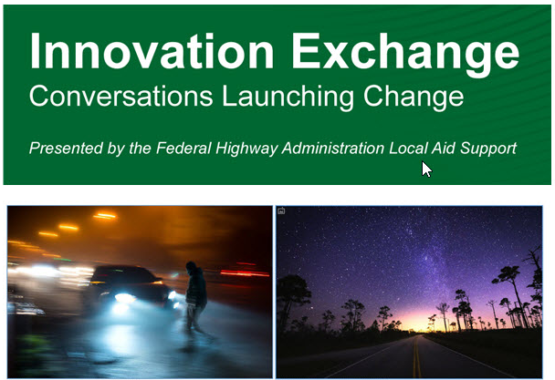
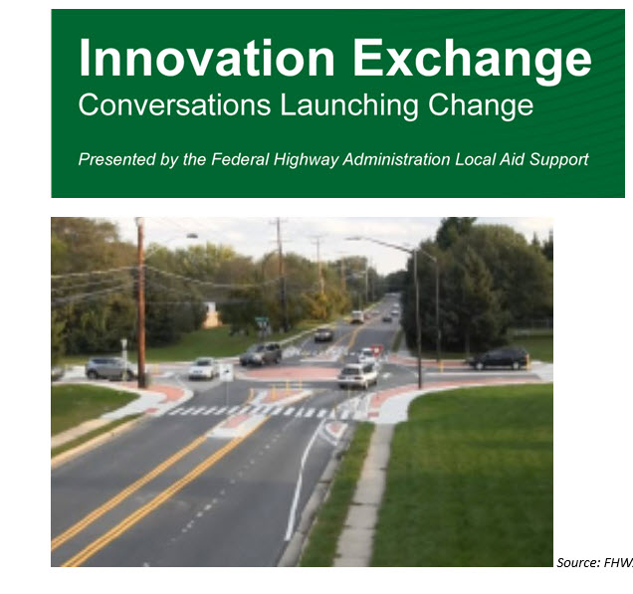
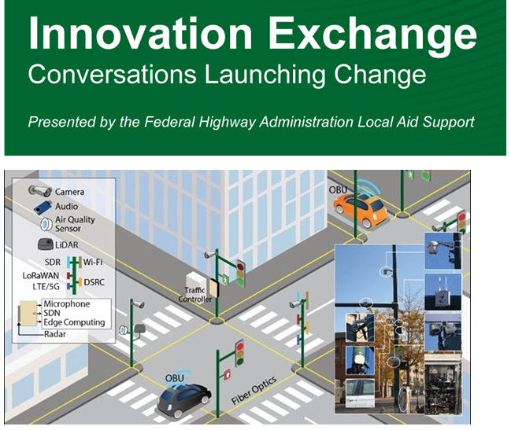
Innovation Exchange Monthly Webinars
Encourage Peer to Peer support by sharing Innovative Solutions
Nighttime Visibility
Smart Intersections
Ice Roads
Mini-Roundabouts
SMART Intersections
Notes:
In addition to managing the LTAP TTAP, we hold monthly webinars called the Innovation Exchange.
Averages 200 attendees per webinar over the course of a year.

Slide 23
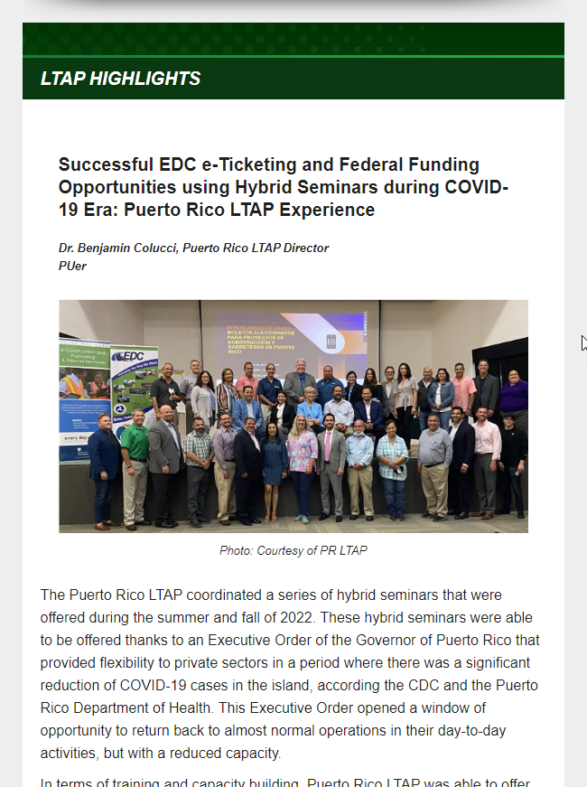
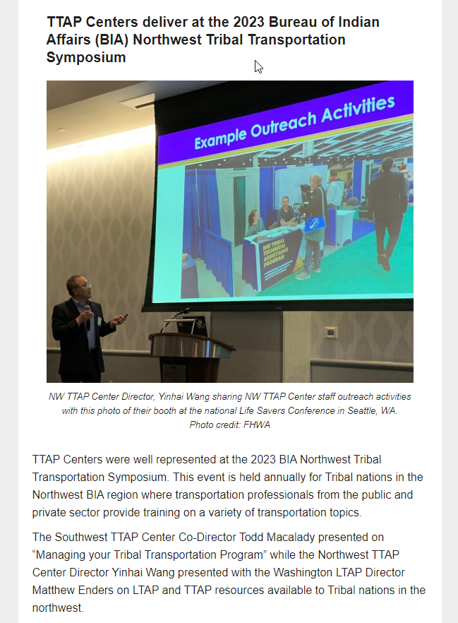
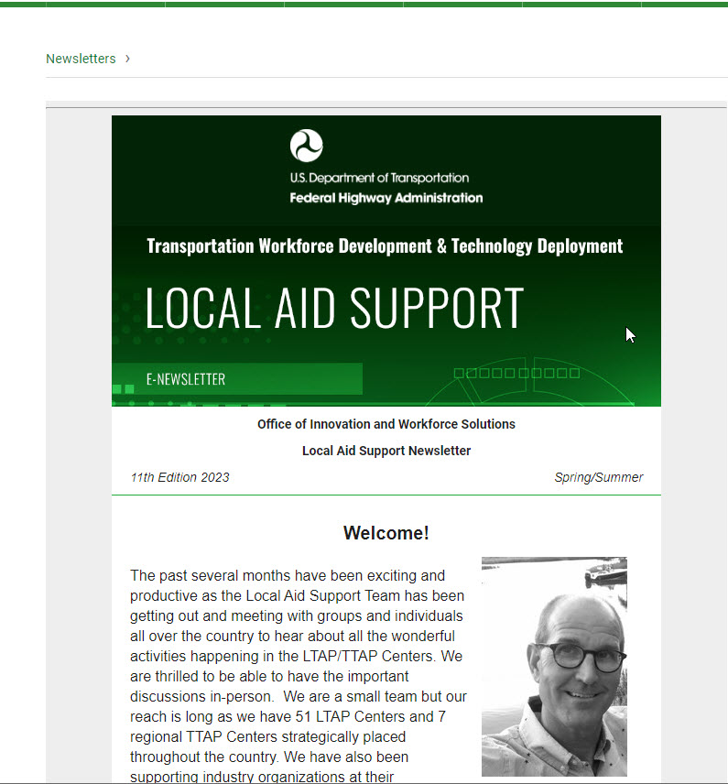
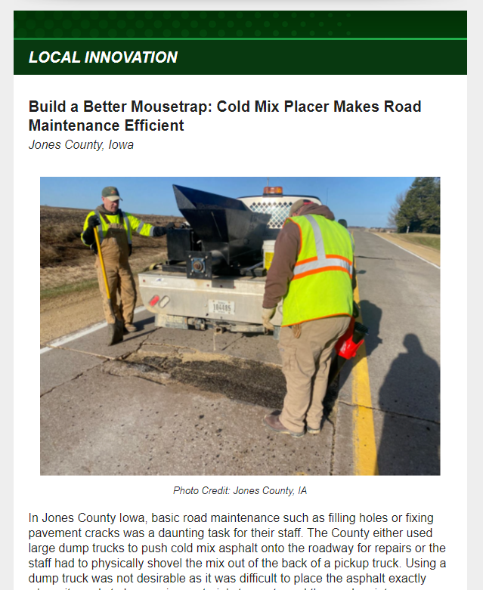
Quarterly Newsletter
Notes:
100,000 Subscribers

Slide 24
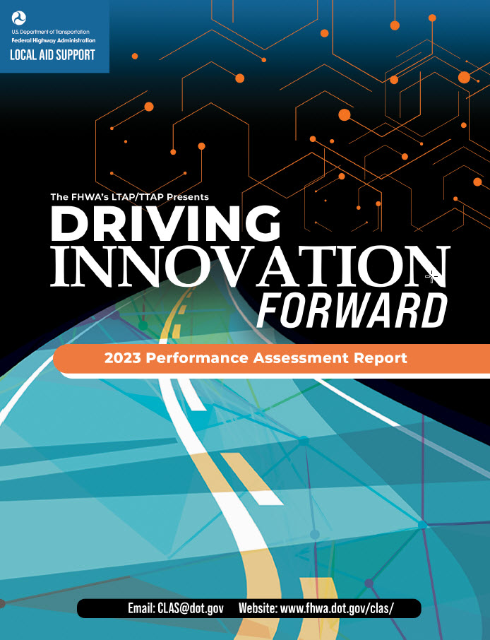

Reports
Notes:
Tell their stories

Slide 25
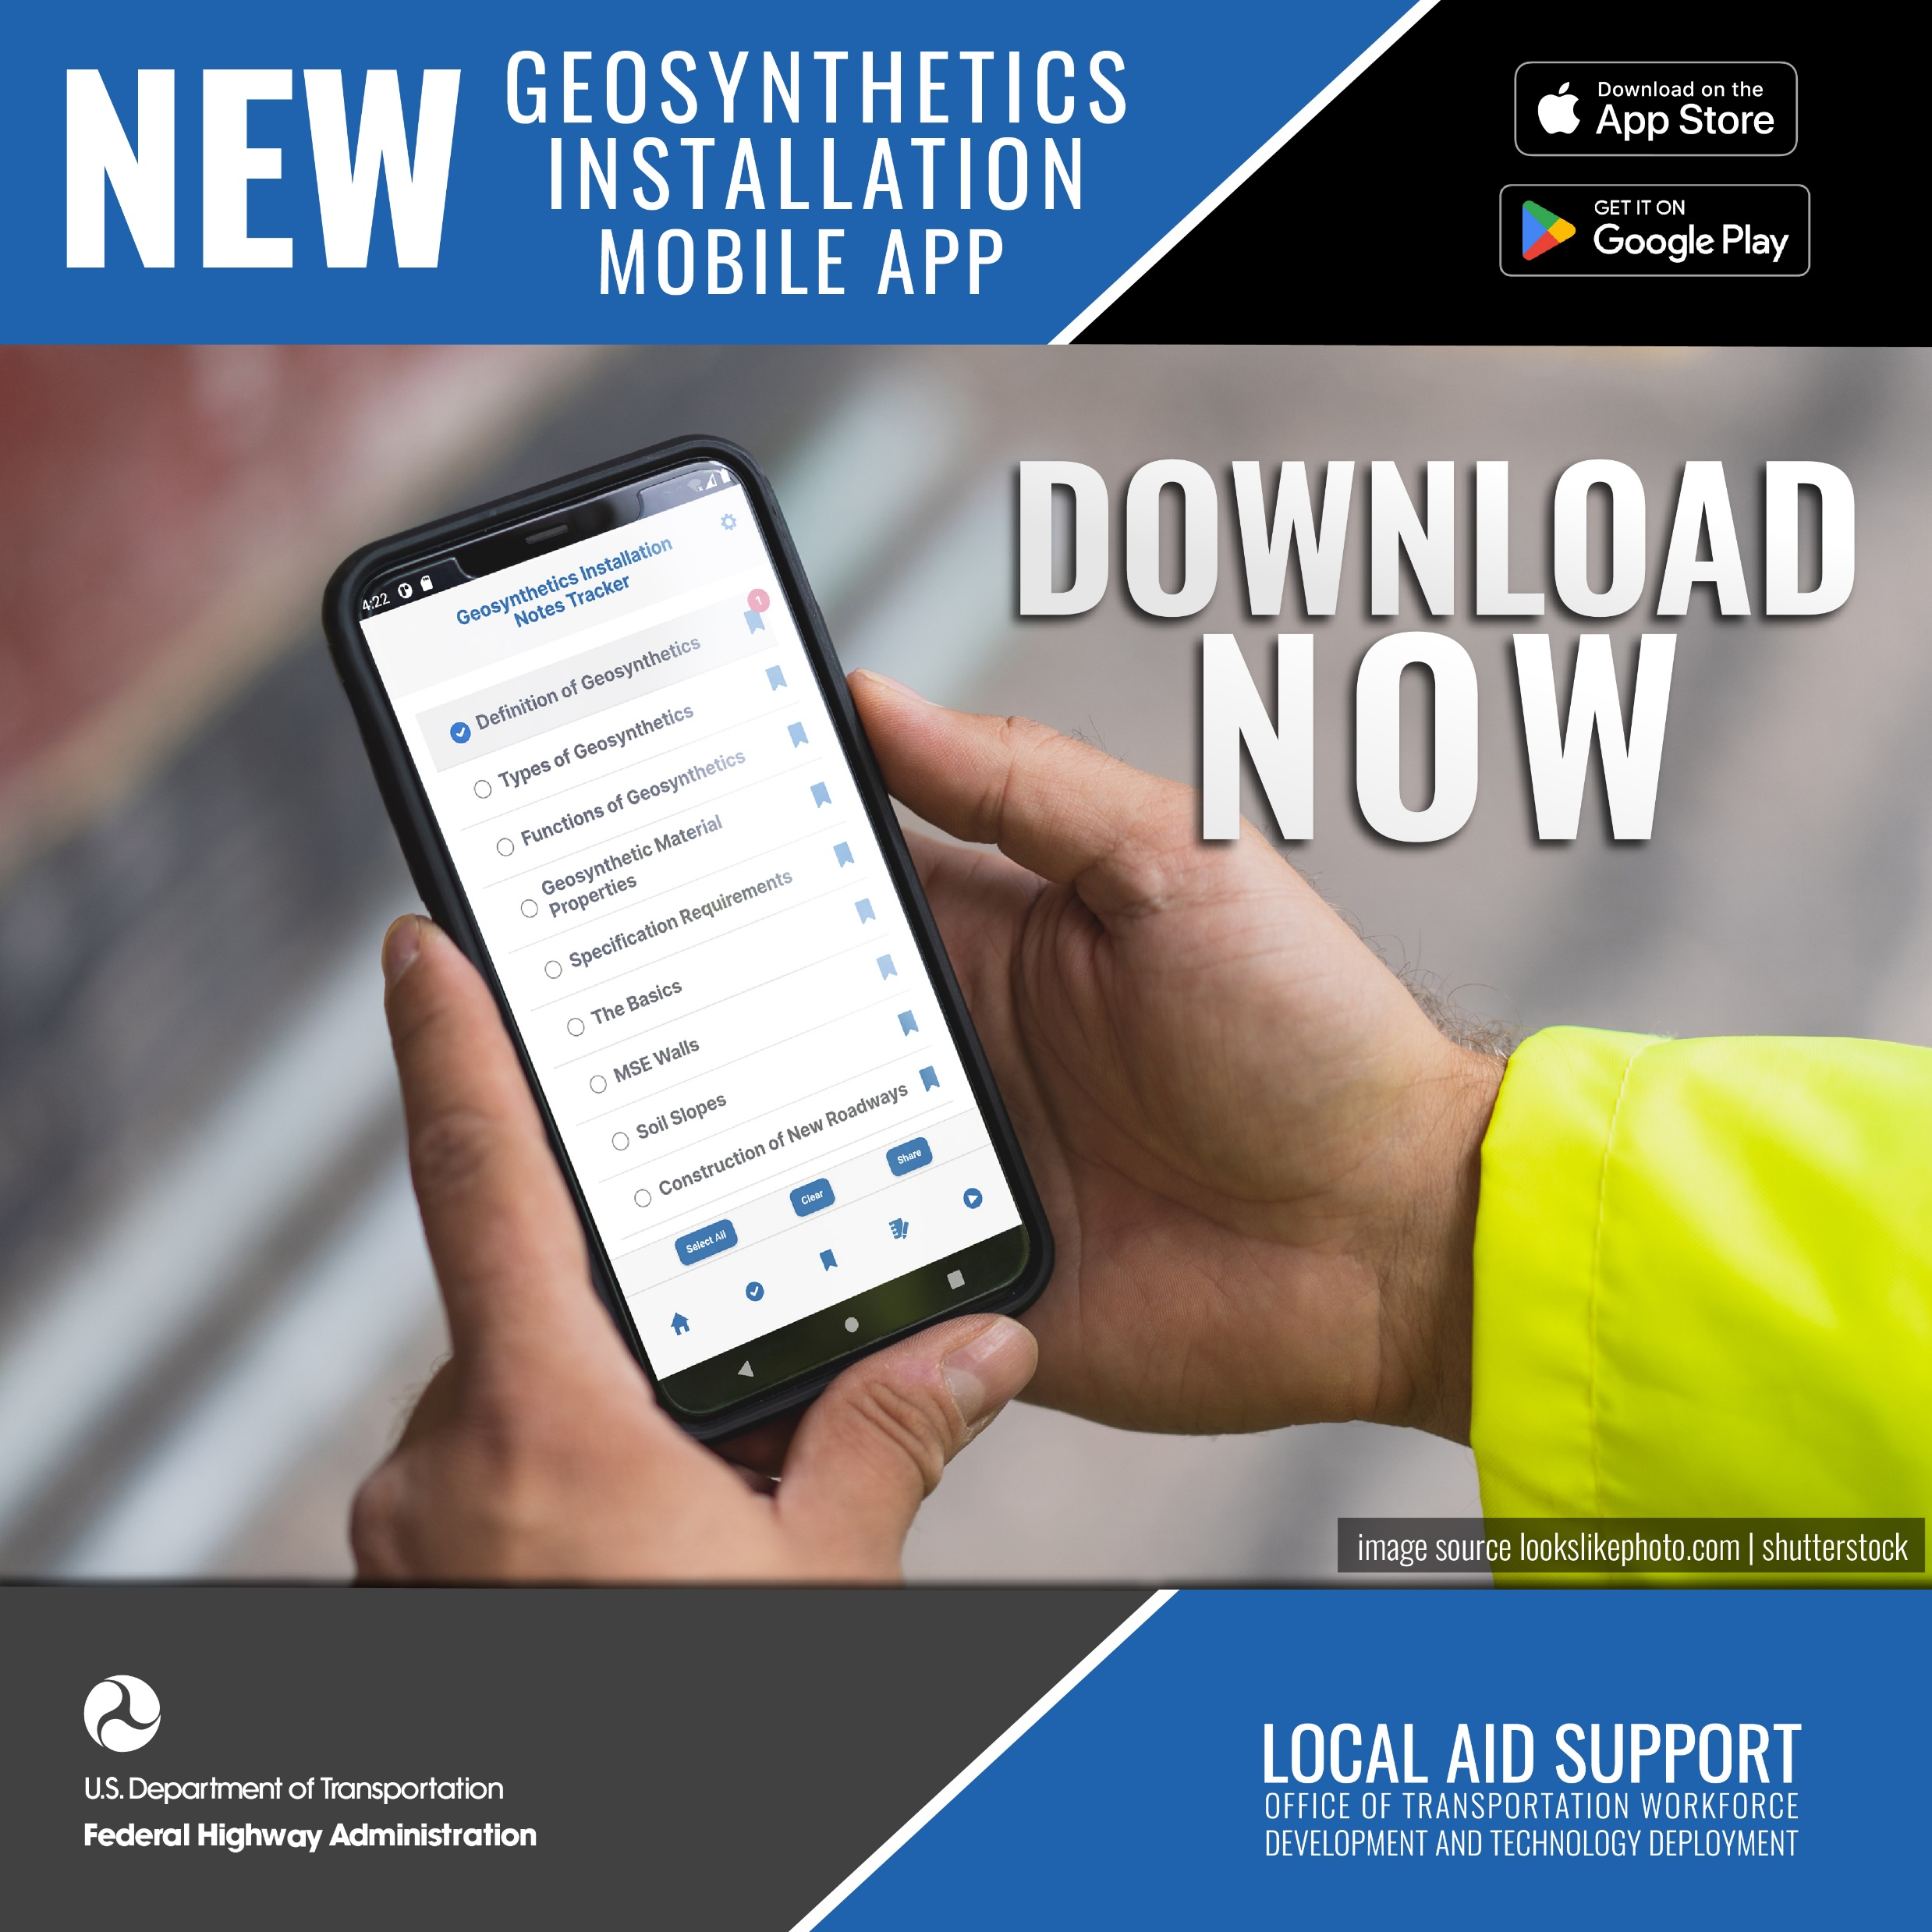
Geosynthetics Mobile App
Collaborative effort between FHWA and the Geosynthetics industry
Provides information on the types and function of geosynthetic materials, specification requirements, and site inspection guidance for walls, slopes, pavements, erosion control and drainage
Provides easy on-demand access to information used by construction inspectors, project managers, and maintenance staff
Provides easy navigation to information
Features include:
Quick searches
Notes
Bookmarks
Glossary for key terms
FHWA and Industry videos
Notes:
1700 downloads, so far. Please help us spread the word on the availability of this app at no charge. https://www.fhwa.dot.gov/clas/geosynthetics/
https://www.youtube.com/watch?v=Dr-gRj_Libw 3:02
https://www.youtube.com/watch?v=sVQ2UhX-WnA :55

Slide 26
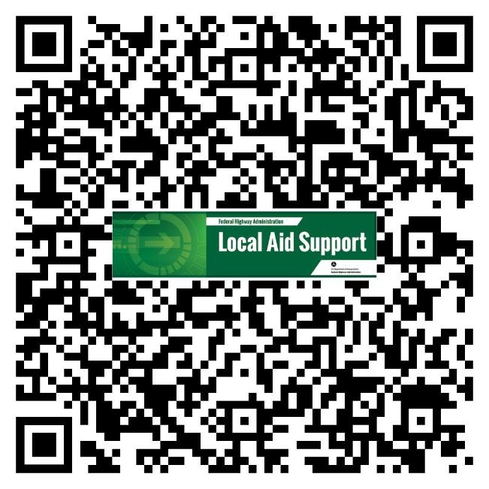
Stay Connected with LAS
Local Aid Support Quarterly Newsletter
https://www.fhwa.dot.gov/clas/newsletters/
To sign up:
https://public.govdelivery.com/accounts/USDOTFHWA/subscriber/new?topic_id=USDOTFHWA_153

Slide 27
Strategic Workforce Development Update-WFD Phase ll
Ray Belk
Texas Local Technical Assistance Program (TxLTAP)
University of Texas at Arlington

Slide 28
5 Stage Employee Attraction and Retention Model
State Transportation Innovation Council
Project 5-9055-01 Update July 25, 2023

Slide 29
The 5 Stage Employee Attraction and Retention Model – Project Overview
In the public sector, especially in the Public Works/Road and Bridge departments, many cities and counties need help to keep good employees, find quality replacements, and then develop them with the hopes of them staying with the organization.
The project is designed to assist cities and counties in overcoming those challenges, improving recruiting, and reducing attrition of quality employees.
As a result, the 5-Stage Model to Attract and Retain Employees for Public Works and Road & Bridge Departments for Texas Cities and Counties has been developed.

Slide 30
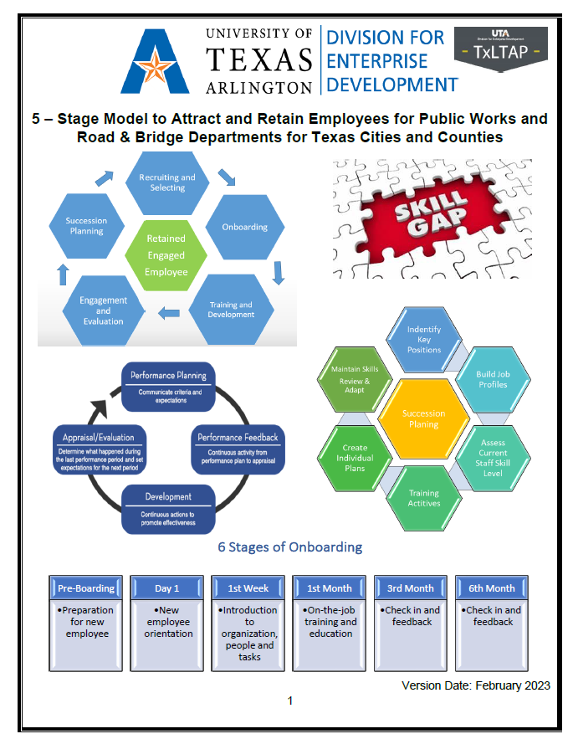
A preliminary Guide was developed with limited distribution to gauge interest and effectiveness of the 5-Stage Model.
It has been well received.
A finalized Guide will be produced no later than August 31, 2023.

Slide 31
Additional information, suggestions, and advice have been received from the partners engaged in developing the preliminary Guide.
Suggested changes will be made and incorporated into the finalized version of the Guide.
Contributing partners include:
Lori Ardoin – Orange County
Tania Rushing – Wichita County
Baby Raley – City of Richardson
Kevin Godley – Bexar County (also member of the TxLTAP Advisory Board)
David Sanchez – City of Amarillo
Haley Smithson – Wichita County
Dana McWilliams – Ector County
Don Spear – City of Dallas
Kelly Rodriguez – City of Killeen, Texas Municipal League Trustee
Amanda Lehde – North Texas Tollway Authority

Slide 32
Retained
Engaged
Employee
Recruiting
Onboarding
Training and Development
Engagement and Evaluation
Succession Planning
5-Stage Model
Recruit
Onboard
Training and development
Engage and evaluate
Succession planning
The model is scalable, allowing users the flexibility to use stages independently, in any order, or use what is best for them.

Slide 33
Resources developed and included in the draft Guide include:
Proven approaches to recruiting employees into a public sector job.
Onboarding strategies and processes recommended for cities and counties to bring on new hires for higher retention rates.
Training course resources recommended for new hires, regardless of job classification.
Training courses recommended for Public Works/Road and Bridge personnel.
How to tie training, job descriptions, and employee performance plans together for continuous employee engagement.
Employee engagement tools and strategies include personal and professional development, coaching, mentoring, and employee recognition programs.
Providing guidance on which tools may work best for them depending on the size of their organization or unique needs.
All tools will be downloadable from the TxLTAP website, which allows editing by the end user to meet their own unique needs.

Slide 34
Facts, Myths vs. Reality, and FAQs
For those tasked with the management of Public Works/Road and Bridge employees, a series of facts surrounding employee retention have been provided for their consideration. Myths vs. reality that prevail in some workplaces on why not to implement a program to retain employees were also addressed. Frequently asked questions about the program were also provided.
Examples include:

Slide 35
Fact: Your organization competes with the private sector and many other public sector organizations to attract and retain the best employees possible.
Fact: Whether you are a metro, urban or rural city, or county, you will have employee turnover. Your high turnover rate depends on the programs and practices you have in place today. The fewer practices you have to address turnover, the higher your turnover will be.

Slide 36

Myth: We don’t need a retention program; many people want a city or county job.
Reality: A successful retention strategy aims at decreasing employee separations and attrition by engaging and motivating employees for the long run. Your organization's goals are critical to a successful employee retention strategy. Some of the elements of a sound strategy include:
Salary and benefits that are in alignment with the local area.
Transparent onboarding process.
Work-life balance support.
Productive leadership.
Open communication culture.
Employee engagement.
Source: TeamStage Employee Retention Statistics: A 2022 Overview | TeamStage

Slide 37
Q: What other assistance can I get under this project regarding how to use this information?
A: There are provisions in this project for a well-qualified HR professional consultant to come on-site and help your HR personnel, administrators, commissioners, and managers (you decide whom to bring to the table) to discuss and customize plans for your organization – all at NO CHARGE!
Q: I do not know how to implement a Workforce Retention Plan; where can I get help?
A: This project is designed to provide your organization with a “jump start” to implement a Workforce Retention Plan with the already developed tools. TxLTAP stands ready to provide a consultant to come onsite and help you.

Slide 38


Stage 1, Recruiting, is where many cities and counties struggle. Getting good quality candidates to apply for a job and then selecting a quality candidate on a timely basis is a critical step.
The Guide provides users with resources, ideas, and suggestions on how to effectively recruit the best talent possible regardless of the location or size of your organization.
The key is to get organizations to tell their story to potential applicants.
Some of the resources provided in the Recruiting section of the Guide include:

Slide 39
Leveling the Playing Field:
Strategies for Hiring Public Sector Employees
Despite the challenges we face in the public sector, there are still several effective recruiting strategies that Local Public Agencies (LPAs) can use. By understanding our unique challenges and implementing an effective recruiting strategy for your organization, LPAs can continue attracting good employees.
Benefits
There are numerous benefits that LPAs can offer, and some that the private industry cannot match. Among them are:
Medical insurance
Optional Coverages such as dental, eyecare, life insurance, disability
Retirement plans such as monthly annuities
Paid Leave – sick leave, vacation time
Paid Holidays
Other Paid Leave such as paid leave awards, jury duty, blood donation, voting, recovery time as an organ donor, court proceedings to adopt a child, community service

Slide 40
Leveling the Playing Field:
Strategies for Hiring Public Sector Employees
Benefits – continued
Training and development opportunities
Tuition reimbursement plans
Merit Increases
Longevity pay
13th Check Scenario
* All figures are based on an employee making $18.00/hr
* Full time, 2080 hours = $37,440 annual or $3120/month
Benefit | Monthly Value | Annual Value
Health insurance premiums paid on behalf of the employee | $400 | $4800
Employer-paid contribution towards retirement (6.0% annual salary) | $186 | $2232
Paid time off, 80 hours annual | $120 | $1440
Paid holidays off (varies, but using 10 holidays or 80 hrs) | $120 | $1440
Training attendance, average 80 hours annual | $120 | $1440
TOTALS | $946 | $11,352

Slide 41
Types of Recruiting Strategies
It has been observed and confirmed that many cities and counties only post job openings on bulletin boards and rely on word-of-mouth advertising. Resources have been identified for them to use include:
Job Posting Sites
Facebook
Job Fairs
Hosted local recruiting event
Recruiting at a local event
Open House
Industry event
Local Retail Store
Organizational Job Bulletin Boards
Professional Organization Job Bulletin Board
Universities, Colleges, Trade, and Technical Schools
Setting the Stage for Future Generations – making presentations at local schools

Slide 42
A Word About Job Postings
What information goes into your job posting, whether online or hard copy based, is important. It needs to provide enough information to the candidate but not be too brief or vague and not overwhelming with information. Finding the right balance of information to get the candidate’s attention and outlining high-level job activities is essential.
Job Title Opening and closing date of job posting
General Description/Summary of Functions Primary Duties/Duties and Responsibilities
Minimum Qualifications Benefits and Salary
Licenses/Certifications Contact Information
Physical/Environmental Requirements/Other Information
Legal Wording on Job Posting
The following two slides represent actual job postings from Texas cities and counties. They will be used as examples in presentations at conferences, seminars, and workshops across the state,

Slide 43
This job description leaves a lot to be desired when providing information. The only thing a candidate needs to have is a Texas CDL (A or B?).
Don’t have to lift anything…
Don’t need to operate anything...
Don’t need to work on the roadway…
Don’t have to do any equipment maintenance...
Working hours?
Benefits?
Surprise! To the candidate when they find out what they really have to do.

Slide 44
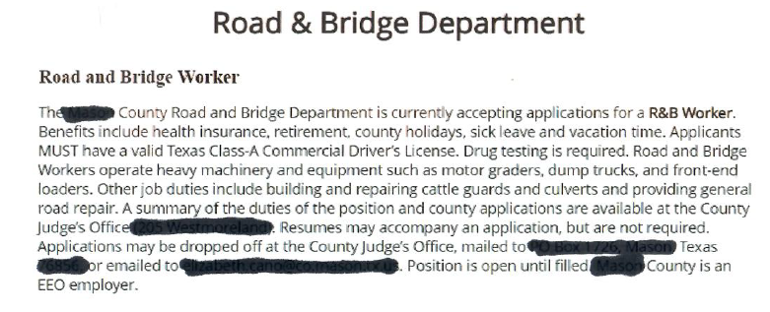
A few things to consider. To obtain more detailed duties, the position requires an in-person visit to the Judge’s office – this eliminates any persons who may reside out of the area to make the trip and apply. No mention of a salary or hourly wage. Any candidate will ask, “Is it worth my time to apply?”

Slide 45
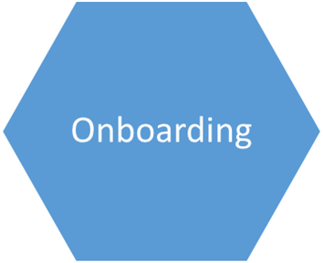

Stage 2, Onboarding. Many organizations need an onboarding strategy or process for new hires. Without an onboarding strategy or process, it is up to their supervisors to handle new hires as they have always done in the past.
Some supervisors will explain the job well to an employee and may even assign them a “shadow” employee to introduce them to the rest of the workgroup and walk them through their assigned tasks.
Some of the information provided in Stage 2, Onboarding, follow.

Slide 46
Industry On-boarding Statistics:
Without a structured on-boarding process:
4% of new hires never return after the first day on the job.
20% of new hires leave within 45 days on the job.
33% of new hires look for a new job in their first six months of employment.
90% of new hires decide within six months if they intend to stay or start looking for other opportunities.
23% of new hires leave before their first anniversary with the organization.
With a structured on-boarding process, organizations can realize a:
20% increase in management satisfaction with new hires.
50% increase in productivity of the new hire.
58% retention of new hires after three years with your organization.
Other onboarding statistics:
75% of new hires say training is most important to them in the first six months on the job.
56% of new hires say having a mentor or a “go-to person” is especially important when getting started.
41% of Human Resources professionals agree that their organization needs to improve onboarding.

Slide 47
The benefits of having a structured onboarding process outweigh the reservations or, in some cases, outright objections that supervisors may pose. Benefits of structured onboarding include:
Decreased attrition rates with new hires.
Increased productivity of new hires.
Reduction of EEOC complaints of one business unit using a lean model (or lack of) for onboarding versus another business unit that makes onboarding an investment with the new hire.
Accelerated integration of the new hire into the business unit and the feeling of being a part of the team.
It’s repeatable. It’s in writing; a supervisor should follow the playbook instead of making it up as they go.

Slide 48
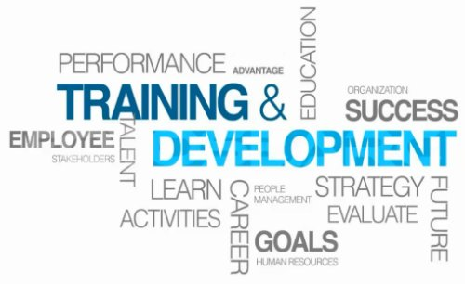
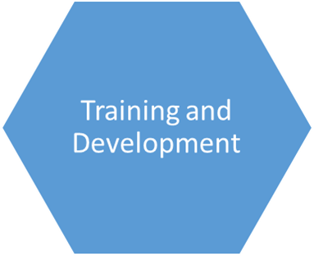
Stage 3, Training and Development (T&D). Numerous references and resources are provided to users in this Stage of the model. Why T&D is important and how to operate T&D Programs is provided.
Some examples from Stage 3 are provided.

Slide 49
Accentuated in the Guide is that training and development activities are available for city and county Public Works/Road & Bridge employees at no cost to the organization.
Instructor-led courses offered by TxLTAP and from TxDOT’s training Catalog (that are open to city/county employees) are listed with learning objectives and how to enroll for those classes with step-by-step directions provided.
AASHTO/TC3 online courses are also listed with learning objectives, a course description, and how to access classes for no charge.

Slide 50
Leveraging information from the 2021 STIC Workforce Development Project, training matrices for the following PW/R&B job classifications are provided in the Guide.
Construction Inspectors I and II
Crew Leaders/Foremen – Public Works/Road & Bridge
Equipment Operators I, II, III, and IV
Fleet Mechanics I, II, and III
General Laborer
Maintenance Technicians – Asphalt specialization
Maintenance Technicians – Concrete specialization
Maintenance Technicians – Forestry & Vegetation specialization
Managers/Supervisors – Public Works/Road & Bridge
Traffic and Signal Technicians I and II
Truck Drivers I, II, and III
Training matrices identify suggested training for each job classification. Customized WFD plans have been developed for over 45 counties in the past three years to meet city or county needs.

Slide 51
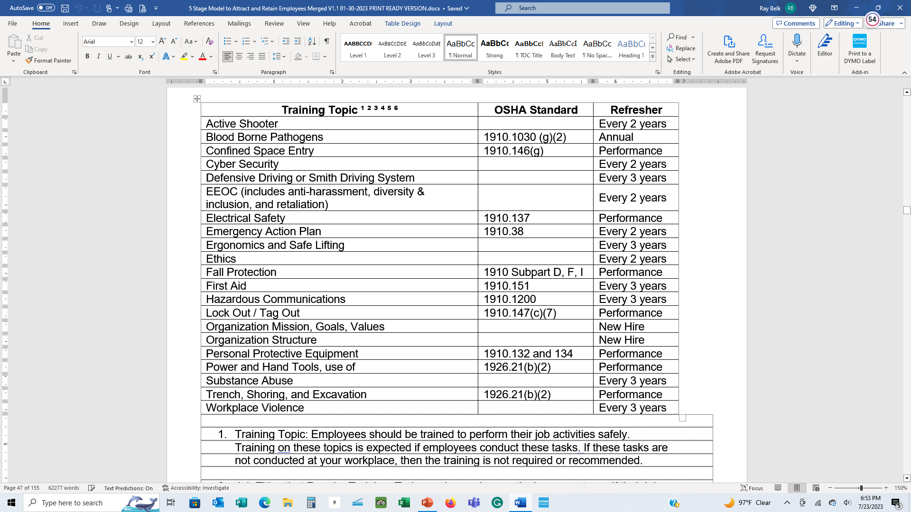
Suggested New Hire training is provided in the Guide with refresher cycles for all employees to help cities and counties become and remain compliant with federal and state regulations.

Slide 52

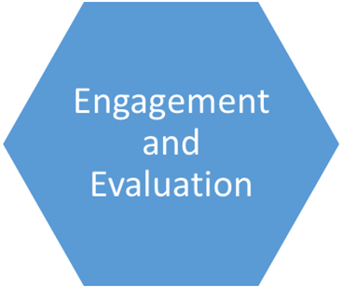
Stage 4, Employee Engagement and Evaluation processes, must occur for organizations to retain quality employees.
A critical step of continual employee engagement is conducting structured, periodic evaluations on employees to let them know where they excel, where they can push themselves to improve, and where they may have challenges they can self-correct.
The following are examples from Stage 4 in the Guide.

Slide 53
What is Employee Engagement?
Once we have hired an employee, done a good job of onboarding them, and they have completed some training, it does not mean we now ignore them and use them as a resource to get the job done. If we want them to remain with the organization, grow with it, and be productive, we need to engage them continuously throughout their career.
You may choose to use all the suggested Employee Engagement strategies listed, or only a couple of them or only one, depending on your comfort level and unique needs for your organization. At a minimum, you should recognize that the strategies listed work for many organizations when properly implemented and managed. Suggested strategies as part of the continual Employee Engagement process include:
Personal and Professional Development
Performance Plans and Performance Evaluations
Coaching
Mentoring
Employee Recognition Programs

Slide 54
Performance Plans and Performance Evaluations
What is the Difference Between a Plan and an Evaluation?
A performance plan should be implemented either at the time of hire or at a regularly scheduled point in time for all employees, such as September 1st of each year for all employees in the organization. A plan outlines what the manager expects of the employee regarding the quality of work, safety on the job, completion of work tasks, development, training activities, getting along with others, and so on.
A performance plan is a working tool for any supervisor. They should refer to it often to see how any employee is performing. If you are an employee, you should look at the plan occasionally and rate yourself on the expectations of the plan.
A performance evaluation is precisely that, an evaluation of the criteria that were in the plan. The review will rate the individual job activities and general factors of how well employees completed their tasks. It will also acknowledge exceptionally well-done projects by employees, their work ethic, problem-solving skills, etc.

Slide 55
Benefits and Reasons Why Cities and Counties Should Have Plans
Both the employee and manager know what is expected.
No more if’s, but’s, or I didn’t know – plans laid out in writing and acknowledged by the employee what is expected of them on the job. The plan removes any surprises for managers and employees when they know what is expected.
The plan allows for employee development.
All plans should have a section on the evaluation form that allows for documentation of completed development (training) activities in the current evaluation cycle and the next cycle, where a new plan is put into place. Employees should have a definite say in expressing what training they will benefit from to help them grow with the organization.
Plans substantially reduce the risk of litigation based on employee work habits.
Plans also document the expectations of the quality, performance, and production expected of all employees and supervisors. Using a standardized evaluation process should remove any personal bias in the ratings. You have documentation based on criteria that should be applied equally to all employees. Having a standardized evaluation process can reduce or eliminate any claims of discrimination.
There are many more benefits in the Guide.

Slide 56

It is projected that in September 2023, the TxLTAP Center will launch a new 8-hour class on writing, presenting, monitoring performance, and closing out a performance plan and evaluation with employees, the LTP405 Developing Employee Performance Plans and Conducting Employee Evaluations (project Task 3).
Course Description: This course is designed for city and county commissioners, supervising engineers, directors, supervisors, managers, superintendents, crew leaders, and other personnel evaluating employee performance. This course will cover the benefits of having performance plans, how to write plans, how to engage employees during their performance cycle, and how to prepare for and conduct the final performance evaluation. Numerous resource documents will be provided with the course, including a Plan/Evaluation Form, recommended Job Duty Phrases, Core and Managerial Core Competencies Guide, and Effective Performance Phrases. The class will conduct a three-part exercise on writing a plan, monitoring performance, and then writing and scoring a Performance Evaluation.

Slide 57
Sample Learning Objectives:
Describe the various needs for having employee Performance Plans in place.
Describe the risks of not having Performance Plans or Performance Evaluations.
Describe the various components of a Performance Plan / Performance Evaluation.
Explain how Stage 1 - Performance Planning fits into the Development and Evaluation Life Cycle.
Demonstrate by interactive exercise how to develop job duties that are SMART-based.
Describe what job duties should be included in a Performance Plan.
Describe the key areas to use when monitoring and measuring performance.
Explain the importance of documenting performance.
Demonstrate by interactive exercise how to prepare, conduct and document a mid-point check-in.
Describe the process and benefits of having employees evaluate themselves.
Describe the Performance Curve and where employees fit on it.
Describe common performance rating problems and how to overcome them.
Demonstrate how to develop accurate and factual ratings on performance evaluations.
Demonstrate through a hands-on exercise how to determine and document final ratings and comments on the Performance Evaluation.
Describe how to handle challenging situations based on disagreements on supervisor ratings.

Slide 58
What are the Differences Between Coaching, Counseling, and Mentoring?
There are distinct differences between coaching, counseling, and mentoring, although many think they are the same. Let’s look at a basic definition of each.
Coaching – Employee coaching refers to when a leader trains employees to improve their capabilities in the workplace and help them develop new professional skills.
Counseling – Coaching is performed to prevent counseling. Counseling takes place when coaching has failed. Counseling an employee reflects that the employee chooses not to perform or meet the set expectations. Counseling is often the first step in developing and implementing a Performance Improvement Plan.
Mentoring – Mentoring is the practice of someone more experienced sharing resources, knowledge, expertise, and skills with those less experienced. The objective of mentoring is deliberate, facilitated learning.
The Guide covers all of these components in detail.

Slide 59

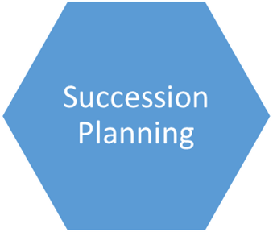
Stage 5, Succession Planning provides guidance and advice on how to engage highly skilled, experienced employees that are reaching the end of their careers and are looking forward to retirement, whose experience and knowledge may be leveraged to help lesser experienced employees with their upward mobility.
Stage 5 provides guidance on how to use those employees to develop others. Additionally, advice on how to plan and develop our future leaders is provided.

Slide 60
Succession Planning
Many in public sector employment believe that succession planning is an activity that is optional for their business. This is not true. While public sector employment is set up for a competitive hire system, succession planning should be a routine that cities and counties should strongly consider using.
Succession planning in the public sector means assessing your individual employees’ potential, strengthening your talent pipeline by making your organization one people want to work at, recruiting in new and innovative ways, creating leaders at all levels, developing employees, and continuously planning succession for all key positions.
If you choose to refrain from engaging in some form of succession planning, the legacy you leave behind could be one that others do not appreciate having to identify and train new talent. Leave behind a great legacy that future generations of management and workers will remember in your organization.

Slide 61
Succession Planing
Indentify Key Positions
Build Job Profiles
Assess Current Staff Skill Level
Training Actitives
Create Individual Plans
Maintain Skills
Review & Adapt
The Guide provides a step-by-step process and suggestions for your organization on implementing and maintaining a succession planning program compliant with state and federal laws.

Slide 62


Slide 63
Ray L. Belk SPHR, SHRM-SCP, PMP®
TxLTAP Consultant
Raymond.Belk@uta.edu
254.289.3443

Slide 64
Break

Slide 65
Weather-Responsive Management Strategies
Kenneth Perrine
Research Associate, Center for Transportation Research
University of Texas at Austin

Slide 66

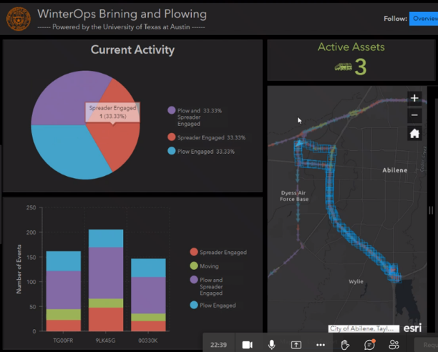
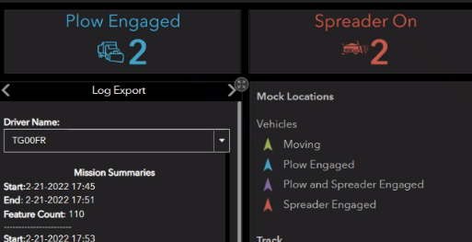
EDC-5 PROJECT CLOSEOUT
KEY OBJECTIVES
Tracking WinterOps activities
  Completely passive to the vehicle operators
  Minimal equipment, no subscription cost
  Interest in other seasonal activities
Identifying how to use the data
  Integrate with existing GIS processes
  TxDOT IMD GIS team involved
  Goal: integrate with TxERA

Slide 67
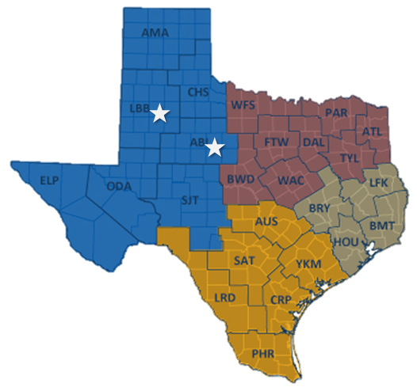
EDC-5 PROJECT CLOSEOUT
WHAT WE DID
Partnered with Abilene and Lubbock Districts:
  4 trucks in Abilene
  (3 plows/V-box spreaders and 1 sprayer)
  2 trucks in Lubbock
  (2 plows/V-box spreaders)
Utilized fleet tracking:
  Verizon Connect… then
  Geotab

Slide 68
PARTICIPANTS
UT Team: Dr. Chandra Bhat, Dr. Christian Claudel, Kenneth Perrine, Lisa Macias, Angela Haddad, and Hassan Iqbal
TxDOT RTI PM: Wade Odell, Darrin Jensen
TxDOT PMC: Charles Tapp, Daniel Richardson, David McDonald, Matthew Heinze, Stanley Hensley, Josh Morton
TxDOT ITD: (TxDOT ITD & FOD): Jason Henderson, Mat Peck
District stakeholders: Abilene: Gary Shelnutt, Scott Cooper, Jeff Parker; Lubbock: Mike Stroope, Jeremy Dearing, James Harger, David Barrera

Slide 69
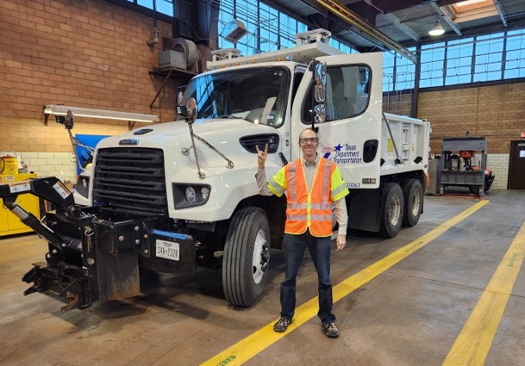
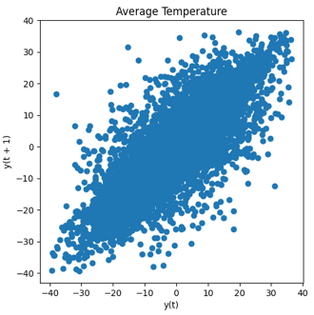
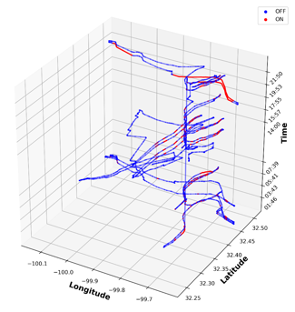
OUTCOMES
Pilot for WinterOps sensing:
  Snow plow, spreader, and brine spraying activity was recorded among 6 vehicles in 2 districts.
  Operating in Winter 2023 with 5 vehicles (+1 in shop)
  Ways of accessing and utilizing data were demonstrated.
Special studies in data:
  Exploring what it takes to replace handwritten logs
  Visualizing data from sensors and data services
  Investigating how to model roadway freezing
Two workshops and one demo event

Slide 70
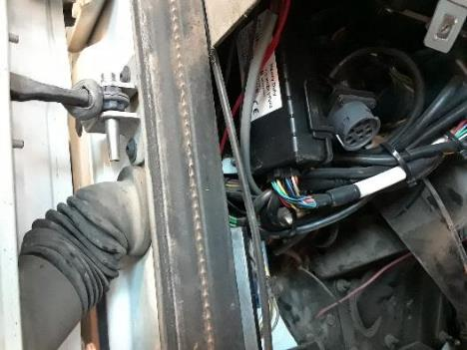
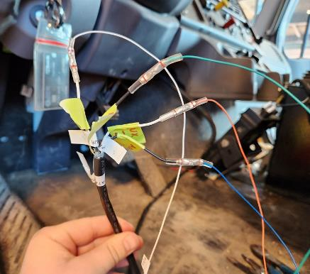
INSTALLATION CHECKLIST
Choose target vehicles. (TxDOT District)
Order IOX-AUX cable harnesses. (CTR can assist)
Order junction boxes and other parts. (CTR can assist)
Install sensing capabilities. (TxDOT District; CTR can assist)
Verify signals in shop. (TxDOT District; CTR can assist)
Perform simple road test and verify signals. (TxDOT District; CTR can assist)
Materials cost: ~$240 per truck

Slide 71
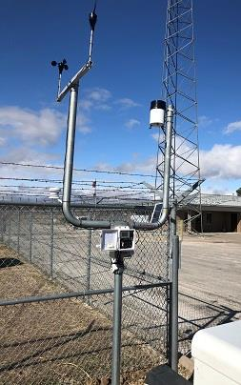
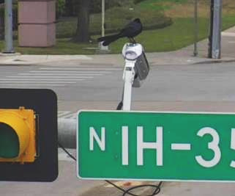


SENSOR OUTCOMES
Sadeem WSS (surface temperature)
  Server support from vendor ceased
Onset HOBOLink RX3000 (weather station)
  4G base unit purchases replaced 3G base units; data retrieved.
High Sierra Mobile IceSight (surface temp. and ice detection)
  Data from Jan.-Feb. ice storm retrieved
High Sierra Fixed IceSight in downtown Austin
  Stopped working last year; too expensive to repair
SK Planet ARHIS (Korean audio-based road surface freezing sensor)
  Cell modem and base unit issues finally resolved in April.

Slide 72
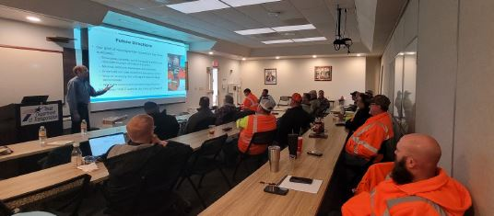
APRIL 2023 WORKSHOP
At TxDOT Abilene District Headquarters
Hardware, GIS, data applications, visualization, freezing prediction, districts needs
Products:
  PowerPoints
  Video
  Schedule
  and Notes

Slide 73
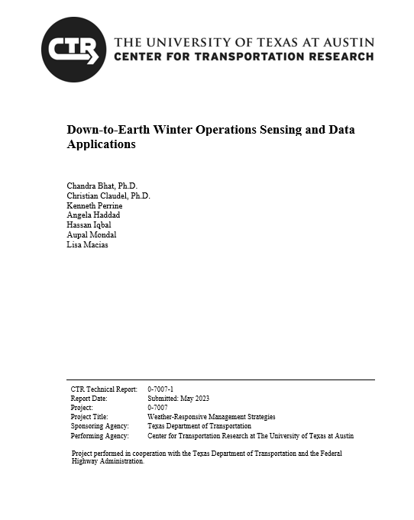
FINAL REPORT
Introduction to WRMS
WinterOps sensing pilot
  Design
  Step by step installation
    PTO, sprayer, spreader, plow
  Experiences and lessons learned
WinterOps data
  Accessing in web UI and CSV files
  GIS processing in ArcGIS Pro
Sensors and data
Non-winter applications

Slide 74
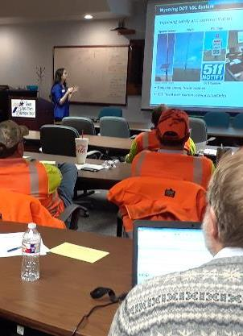
WHERE NEXT?
Outcomes of our WinterOps sensing pilot:
  Snow plow, spreader, and brine spraying activity was recorded among 6 vehicles in 2 districts.
  Minimal additional equipment was necessary.
  Drivers did not need to perform any special actions.
  Ways of accessing and utilizing the data were demonstrated.
  Applicable operations beyond winter were identified.
Thanks, EDC-5! Next opportunities:
  Branch to more districts.
  Integrate GIS processes to TxERA and others.

Slide 75

THANK YOU
Kenneth Perrine, Center for Transportation Research, The University of Texas at Austin
kperrine@utexas.edu

Slide 76
Planning For ITS Growth
Jeff Miles
TxDOT, Bryan District
District Design Engineer

Slide 77

Planning for ITS Growth
Enhancing Quality of Life for All Texans through Technology for All Operations…
August 11, 2023
Notes:
Thank you for the introduction, and Howdy! Today, I will discuss the Bryan District perspective on how to plan for ITS growth as TxDOT continues to roll out innovations looking to improve safety and operations for all of Texas, and anyone passing through our great state.

Slide 78

Questions to Answer…
What is our Goal?
Who are the Stakeholders?
What can we Do?
Why should we do It?
When should we do It?
Notes:
Whenever we look to improve upon anything, we must identify our goal, but often that goal is dependent on our stakeholders. Once these are assessed, that often will help refine what we can do to achieve the goals of our stakeholders. The why is also important, because it helps refine how we might implement what we do, and even when we do it. As my title suggested, I will focus on the planning side of the implementation of technology to solve stakeholder goals, but that is not to imply that technology is the only way that we can innovate for our Texas roadway networks.

Slide 79
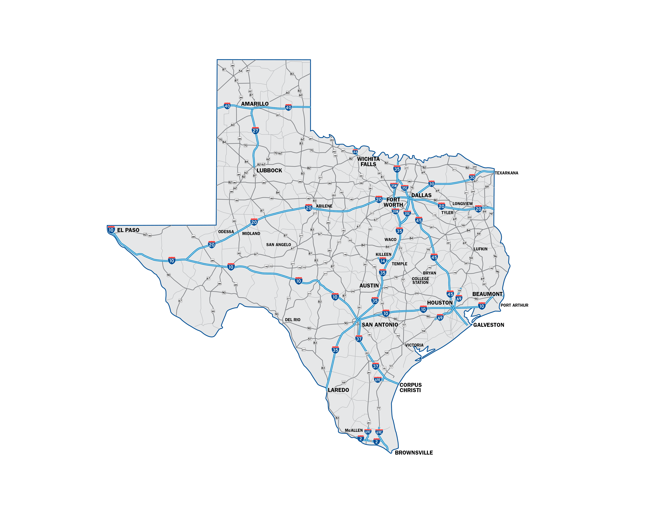
Who: The Stakeholders and Their Stories…
Stakeholders - Story
Worker – Arrive to work safely on-time with reliability.
Commerce – Arrive with goods safely on-time with reliability.
Children – Arrive to school or play safely.
Recreation – Have a safe path to exercise or play.
Vacationer – Arrive to fun safely on-time.
Other – Arrive safely and reliably.
Government – Provide a safe and reliable network for the needs of the various stakeholders under varying conditions.
Notes:
Here are some of the stakeholders that I have identified and their stories. By stories, I trying to assess what their goals might be. The stakeholders really were identified by what they represent as they look to utilize the transportation network. For instance, we have the daily commuter to work or school, and those who would move goods for commerce. We also cannot forget those who may be seeking recreation or vacation. There are various government agencies, such as TxDOT, or even private developers that invest in the transportation network to meet the needs of the various stakeholders. The Bryan District, like all of TxDOT, works to provide safe and reliable transport daily regardless of the time of day or driving condition.

Slide 80
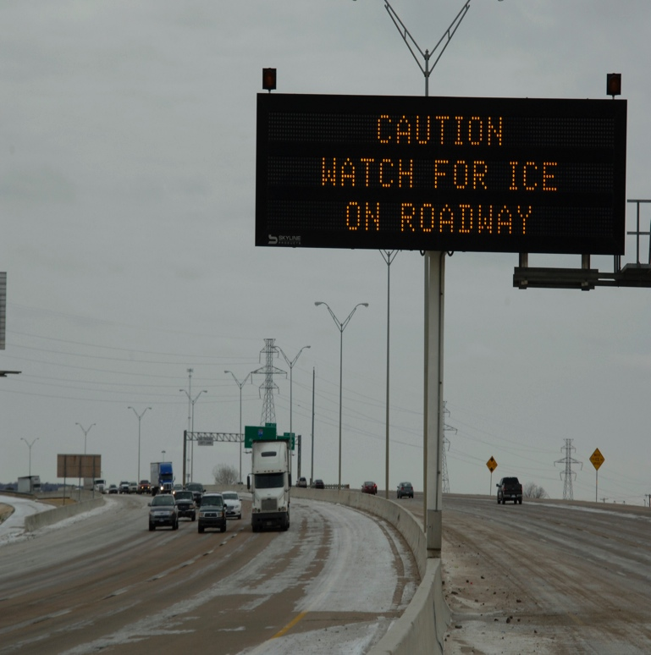
What: Providing Safe and Reliable Infrastructure Requires…
Plan
Build
Lane Miles
ITS/TMS
Maintain
TSMO
Monitor
Adapt
Relay
Equipment
DMSs
Cameras
Sensors
Detection
Speed/Volume
Wrong Way
Overheight
Crash
Notes:
Speaking specifically for TxDOT, we will plan, build, and maintain our various transportation network assets from roadways to shared-use paths, and when applicable, water, air, and rail transport. I would assume we may even help with space transport when considering oversized loads. Transportation Systems Management and Operations (TSMO) is how we implement and utilize intelligent transportation systems (ITS) and traffic management systems (TMSs) to optimize the existing transportation network. Through TSMO we can monitor traffic through the cameras and various sensors, and we can both use that information to adapt our system operations and to inform the traveling public so more informed routing decisions could be followed. Speed and volume data are used for updating current travel times to planning the next major construction project. Wrong way, overheight, and crash detection systems are used to alert the traveling public to safety concerns.

Slide 81
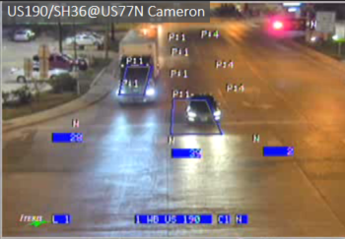
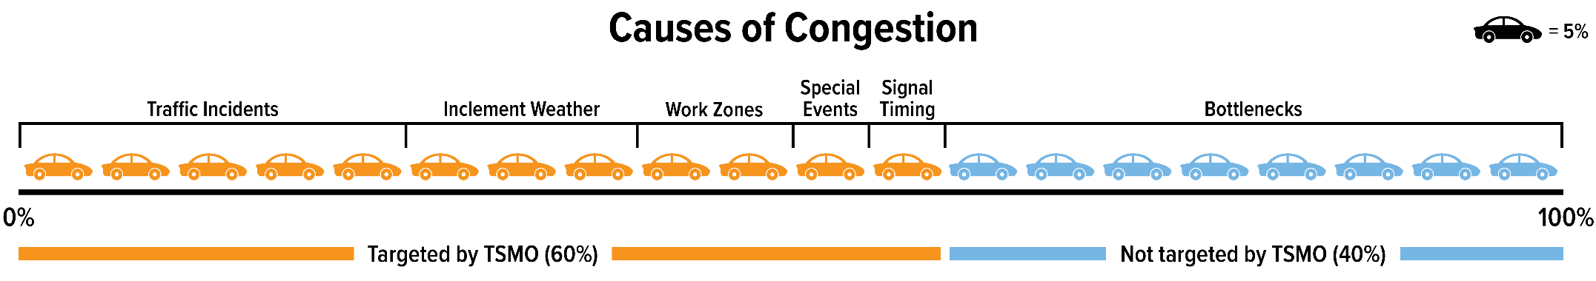
Why and When…
Why
Improve System Safety
Improve System Reliability
Improve System Resilience
Reduce Congestion
Reduce Emissions
Reduce Cost
When… B/C > 1?...
Reliability
Stakeholder Impact
Knowledge Gap
Liability
Perspective
Source: FHWA Traffic Congestion and Fatality Report
www.tinyurl.com/fhwacongestionreport
Notes:
ITS and TMS are at the heart of improving safety and operations for the existing transportation network that will increase system reliability and resilience, while reducing congestion, emissions, and cost.
So, when do we implement these technologies. I suggest that it happens when the benefit to cost, or BC ratio are greater than or equal to 1, but it can be more complicated than that when considering the factors that go into that analysis. Is the system reliable? This is a big question for wrong-way and over-height warning systems. Do they capture all of the violators with minimal false positives? Two additional concerns to implementers should be both knowledge gap and liability. If the knowledge gap to the technology is significant enough that training has not be adequately developed and there is not sufficient staff in the work force, implementation could be slow and inherent with mistakes. Those mistakes could lead to concerns over liability. Liability is further a concern when considering the individual types of technology such as vehicle to infrastructure (V2I) that rely on shared information over multiple vendor and agency platforms. Would it be better to focus on things such as vehicle detection and red extension at signals, and leave the vehicle automatic braking systems to assess the environment solely based on onboard systems?
At the bottom is a chart put out by FHWA that goes to show what is currently believed that TSMO can do for the traveling public. I would suggest that even bottlenecks could be addressed through TSMO by identifying the hotspots for future redesign.

Slide 82
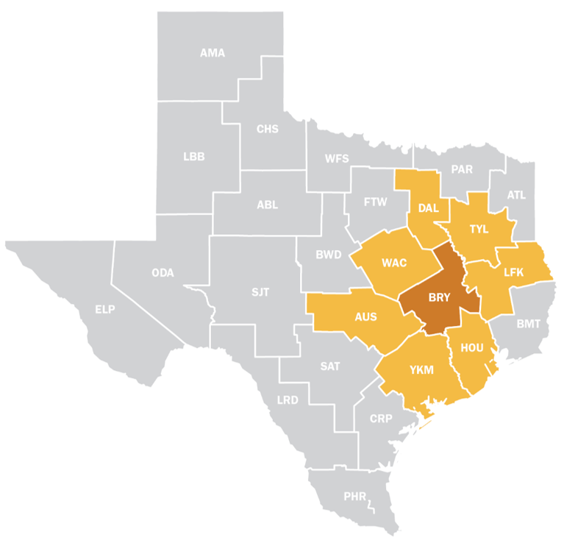
Case Study: Bryan District
2022 Bryan District Statistics
10 Counties
7,710 Square Miles
7,200+ State Lane Miles
489,000+ People
14+ Million Daily VMT
$371+ Million in CST/MNT
100+ Traffic Signals
250+ Beacons
1000+ Luminaires
30+ ITS Assets
ITS/TMS Initiatives
100% Signal Remote Access
Red-Extension on High-Speed Approaches
Extend DMS and Camera Coverage
Work Zone ITS
Speed trailers
Traffic Responsive Beacons
Safety
Design
Technology
Maintenance
- R&D
- Fielded
- Reliable
- Training

Slide 83
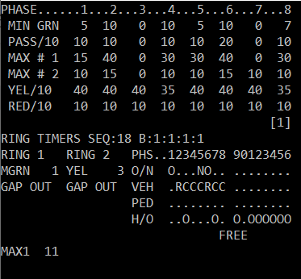
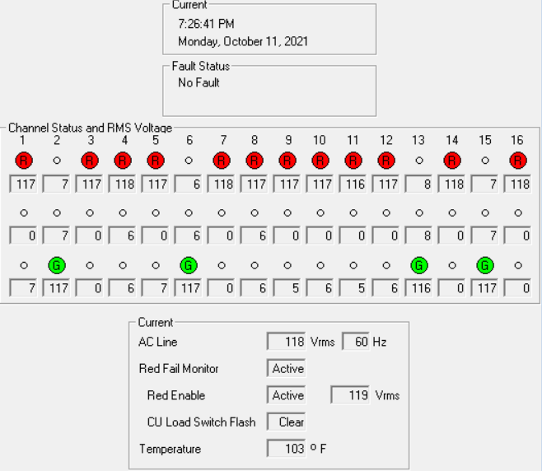
Signal Remote Access
Benefits
Check Equipment Prior to Site Visit
Update (Timing/Detection)
Collect Data (Simple Counts to ATSPMs)
Reduces
  Response Time
  Traffic Exposure
  Repeat Calls
Improves
  System Reliability
  Construction/Maintenance Planning
  Public Perception
  System Safety
    Better meet driver expectation
    Access to advanced alerts

Slide 84
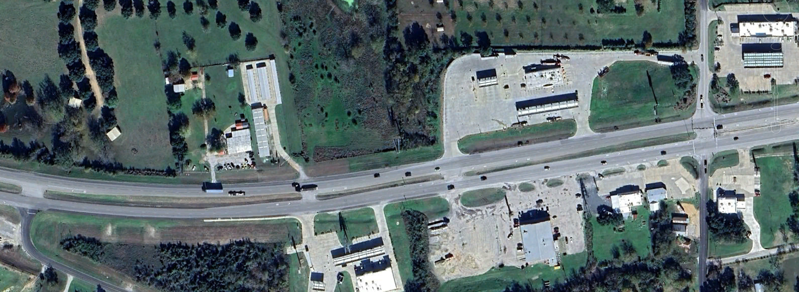
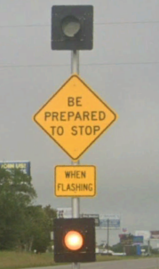


Red Extension: US290 at FM 1155 in Chappell Hill
Existing
FM 1155
US 290
FM 1371
Notes:
This location is a rural high speed freight corridor that also handles evacuation traffic. The existing signalized intersection was approved in 1997, and we are in the planning effort for a grade separation. We have had 72 crashes from 2020 to 2022 with 20% of the crashes with injuries. With the grade separation a long way off, we have already taken some early steps to improve safety, while designing an interim solution that I want to highlight.
Based on crash data and supporting public concerns, we implemented the Iteris Clearguide system 2021. This program adjusts the red clearance interval based on the detected speed of approaching vehicles. This is a screen shot for one day, EB on US 290. Each triangle represents a time that the side street red phase was extended based on the likelihood that an approaching vehicle would run the light. This happened 85 times in one day.
Our second interim solution, we upgraded a signal ahead warning sign equipped with a 24-hr roadside flashing beacon to one that was integrated into the traffic signal. Now, the beacon only activates after the US 290 approach during the yellow and red phases. We believe that the signal actuated beacon will increase driver compliance.

Slide 85


Bryan District: The Hub of Texas
Population Estimates
Texas ~30 million
DFW ~7.9 million
Waco ~0.8 million
Austin ~2.5 million
San Antonio ~2.6 million
Houston ~7 million
~70% of the State
Leveraging DMS and WZ ITS to Get the Word Out…

Slide 86




Conflict/Exposure Analysis
Bryan District Approach
Conflict Analysis
Exposure Analysis
Geometric Improvements
Technology Improvements
  Total Stakeholder Benefit (Safety and Operations)
  Maintenance

Slide 87


The Why…November 7, 2000…
Google Maps, 2021

Slide 88



Slide 89
Acknowledgements
TSMO Consultant Team
DKS Associates (PM, Renee Hurtado)
JM Engineering
ICF
For Questions/Comments…
Jeff Miles
TxDOT Bryan District
Design Section
Jeff.Miles@txdot.gov
737-704-8242

Slide 90
Darran Anderson
TxDOT, Director of Strategy and Innovation
STIC Co-chair

Slide 91
Council Roundtable
Member Updates

Slide 92
Closing Remarks
Erika Kemp
TxDOT, Director, Strategic Planning Division

Slide 93
Adjourn
THANK YOU

